Slide 1

Former Smoot
Tannery Site
Recommendations for
Market-Supported Reuse

Slide 2
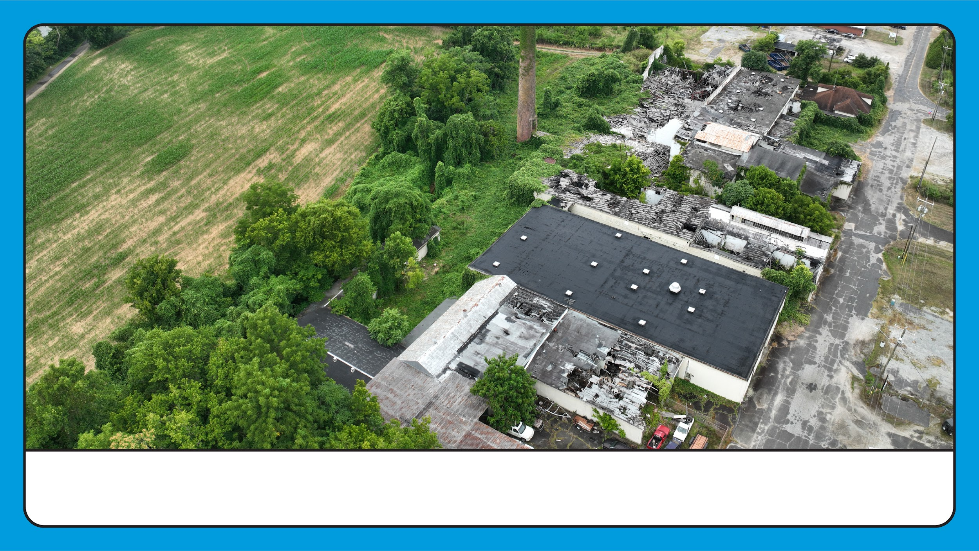
Jenkins Wholesale/Smoot Tannery

Slide 3
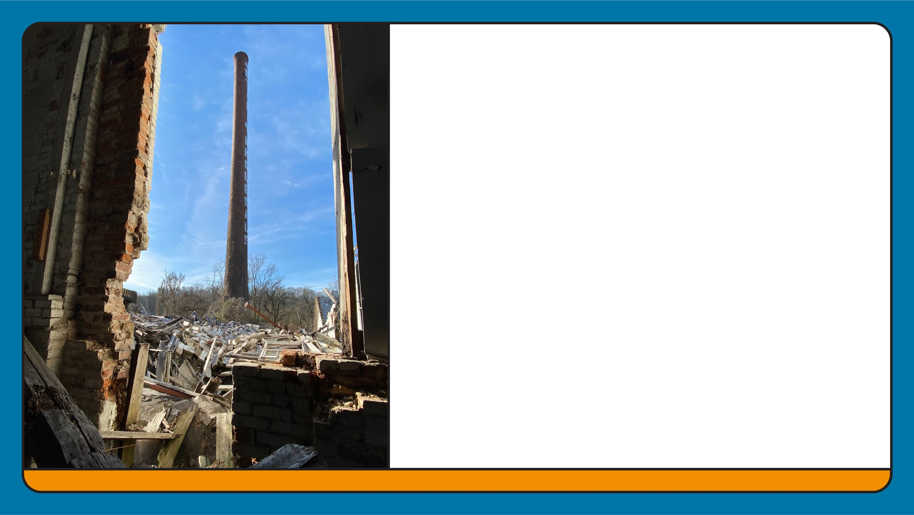
Roadmap to Reuse
This plan outlines the possibilities of redevelopment on this 3 acre site. This property is in the Town’s River District adjacent to Town facilities, boarders our Greenway system and the Yadkin River, including the State’s Blueway system and the Overmountain Victory Trail.

Slide 4
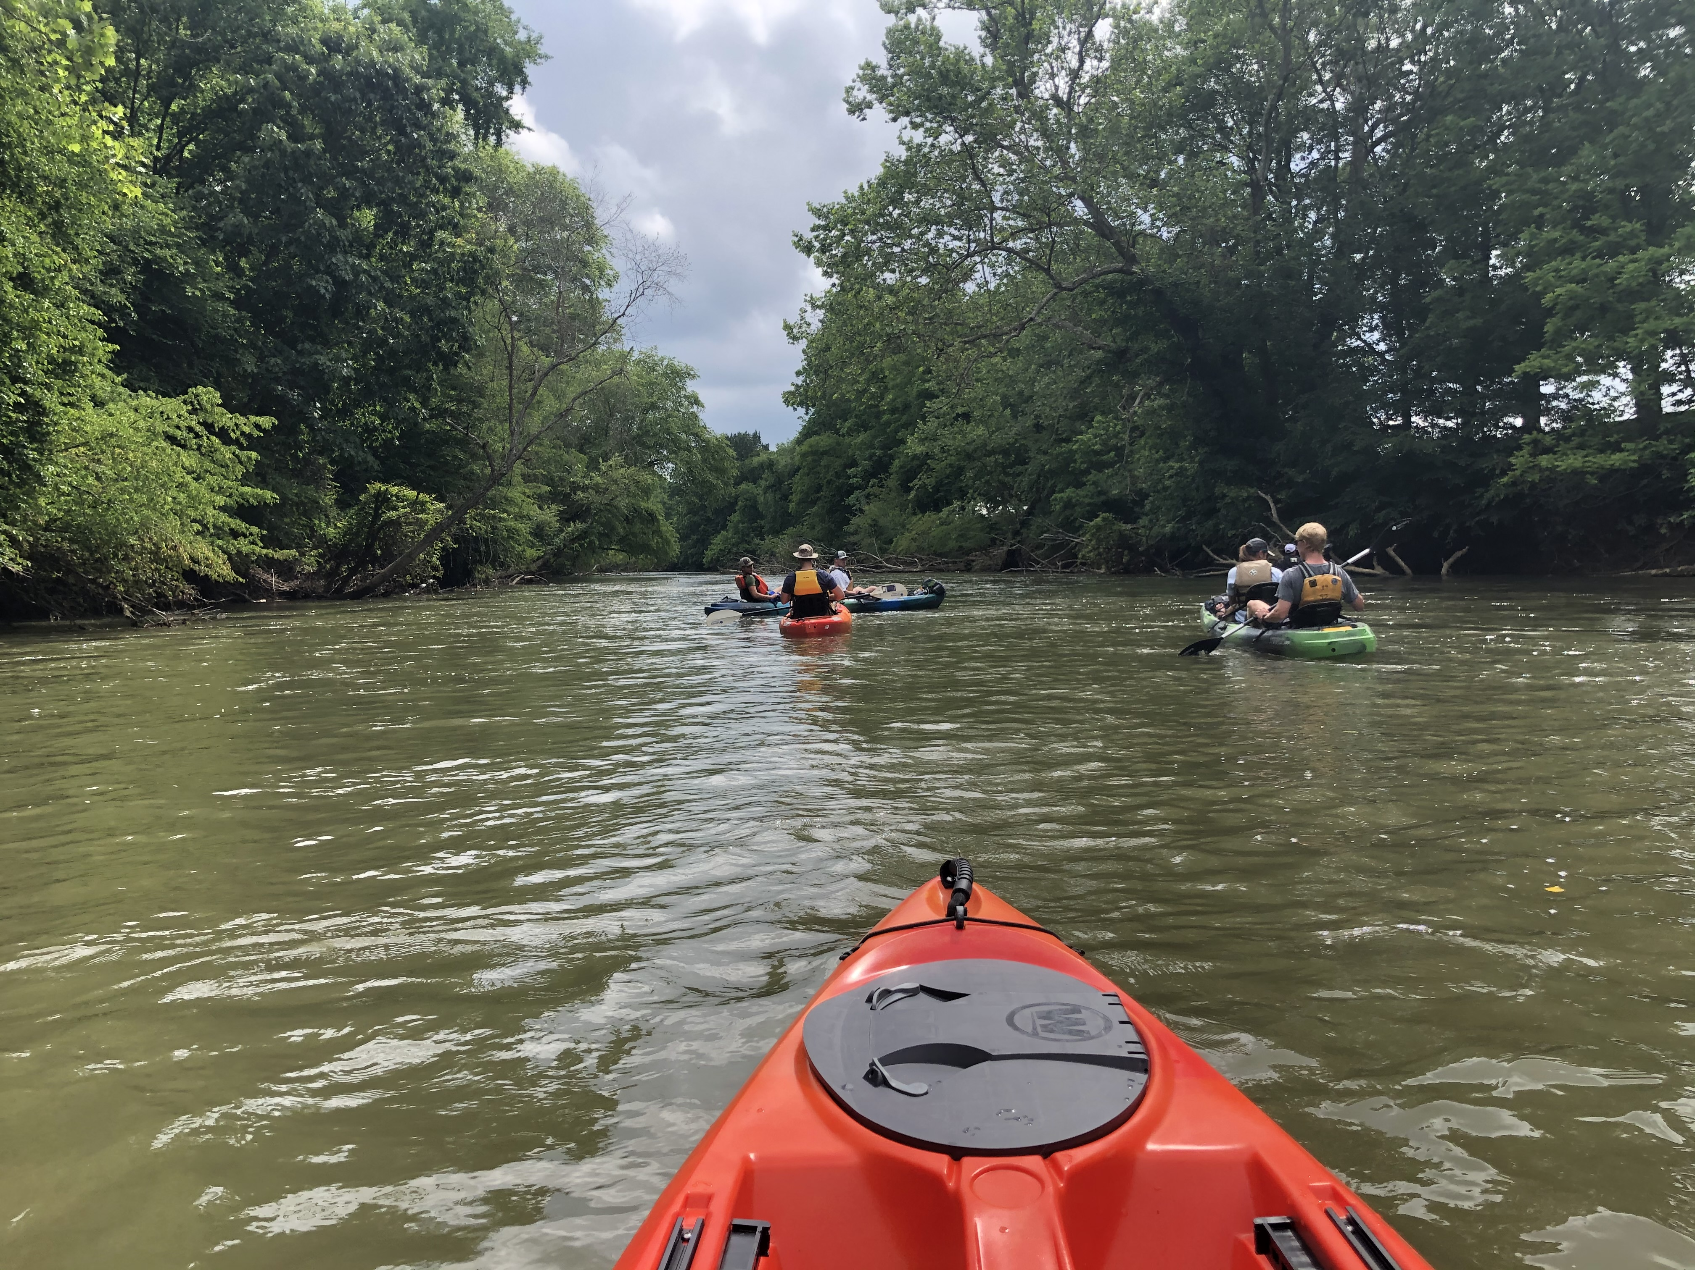
PLAN Goals:
Demonstrate market position of the site
Identify market-supported reuse options (3)
Assess potential future impacts of reuse on our economy

Slide 5
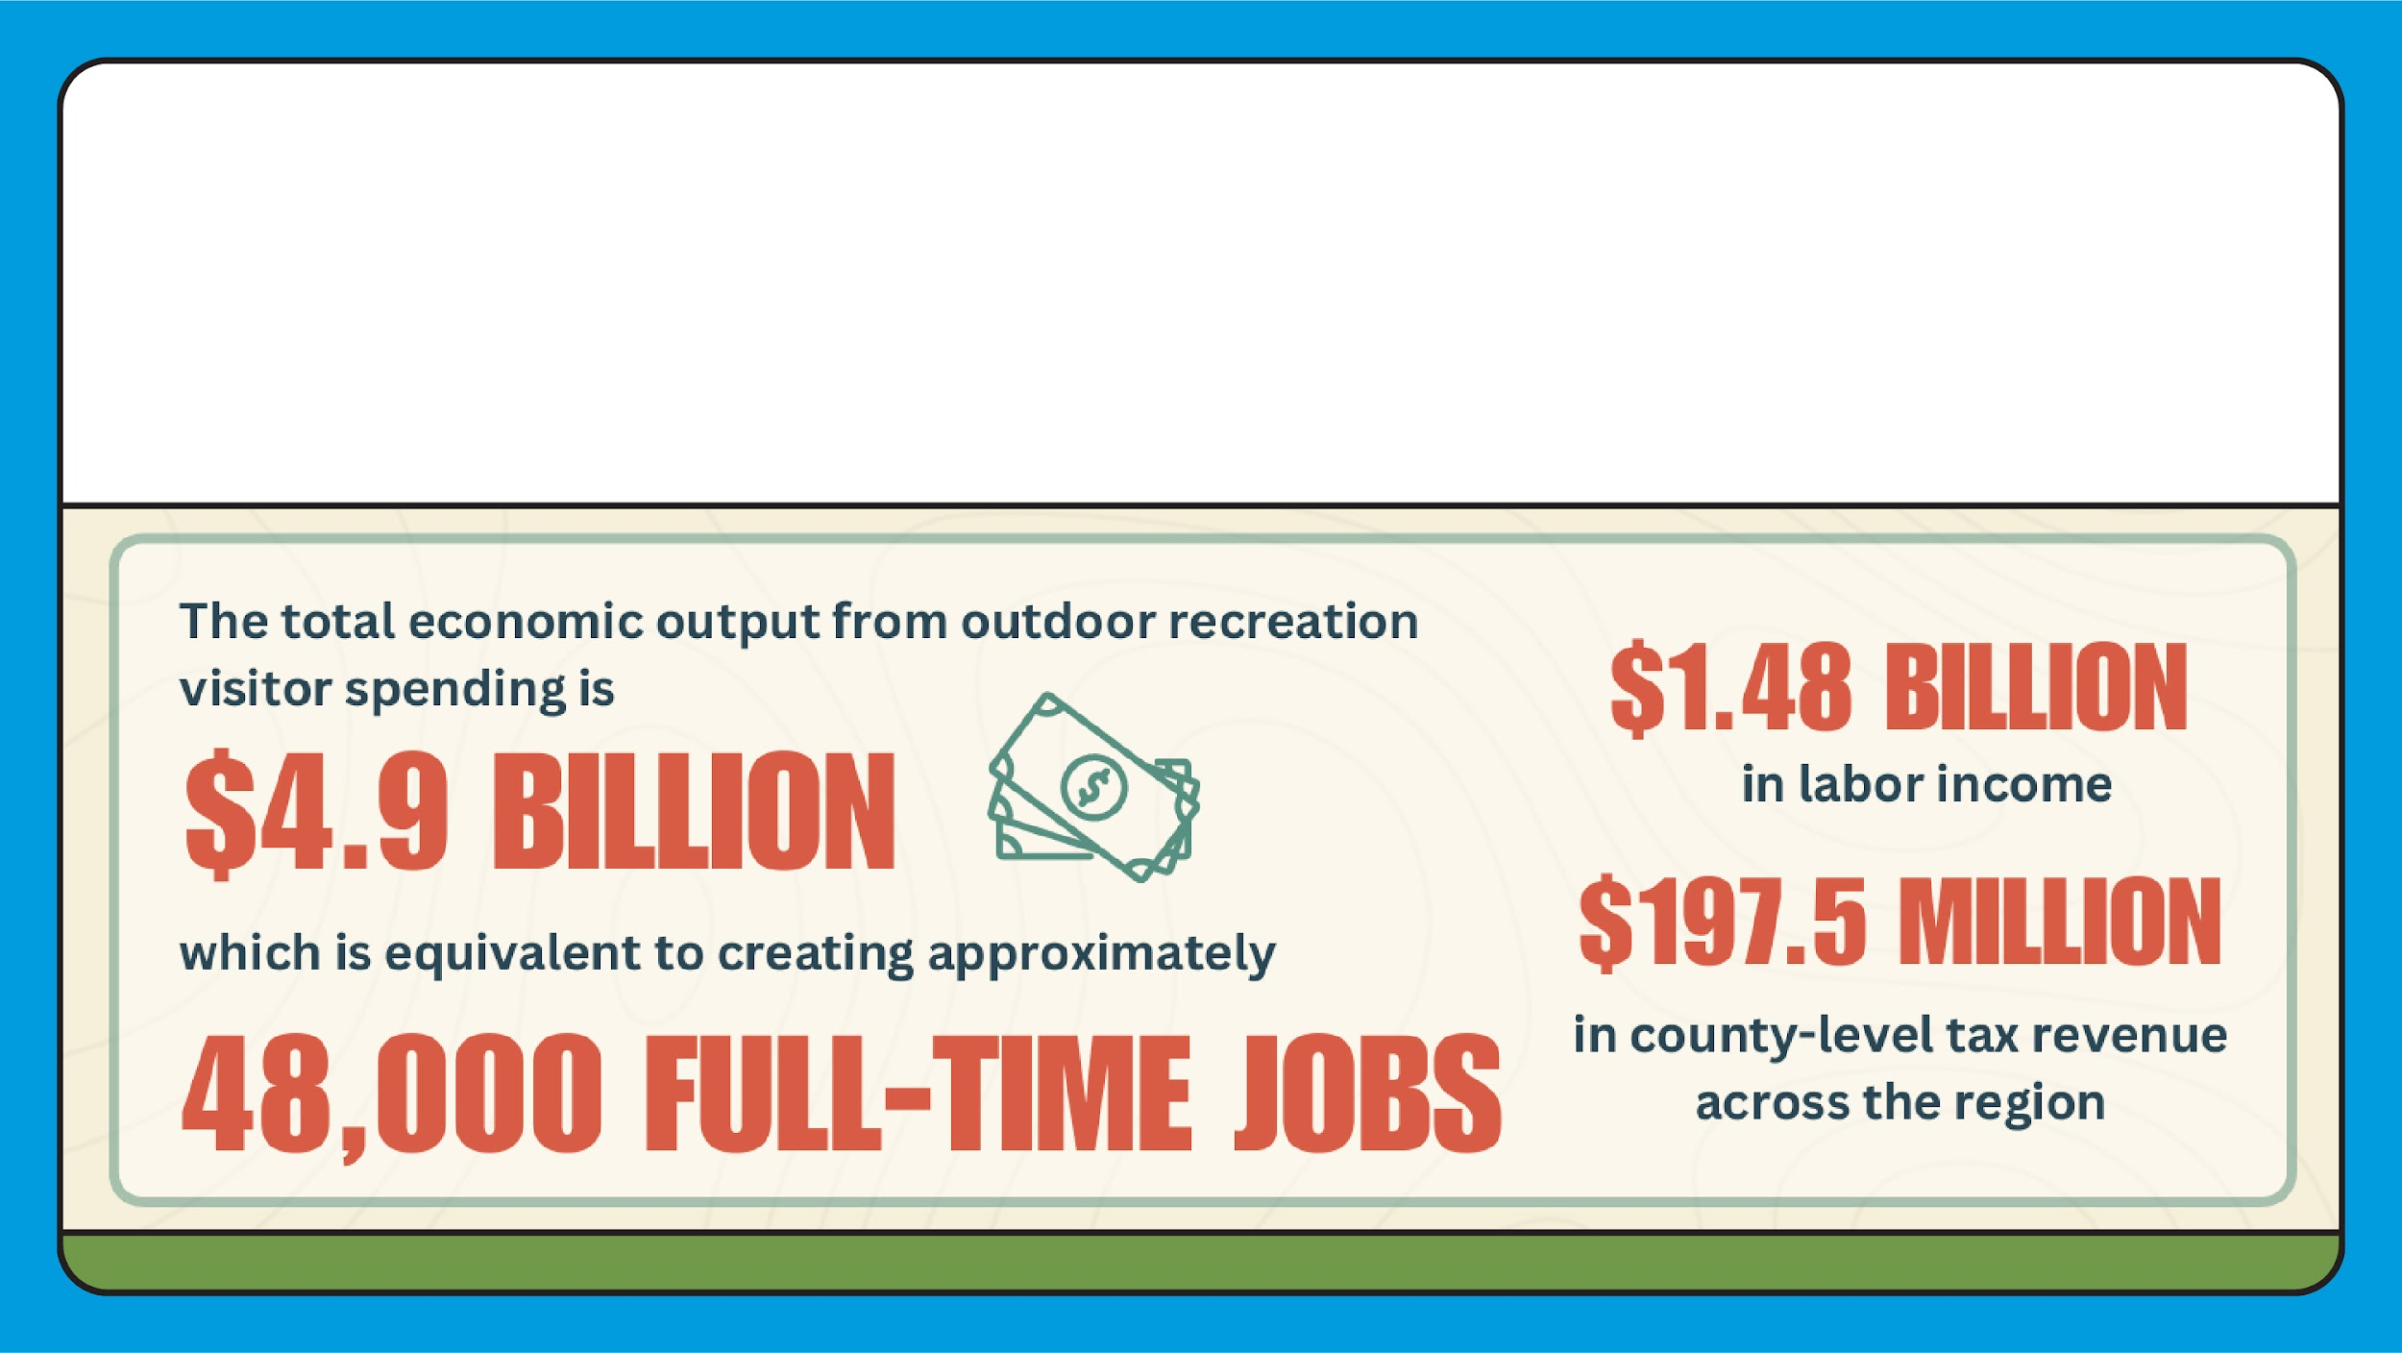
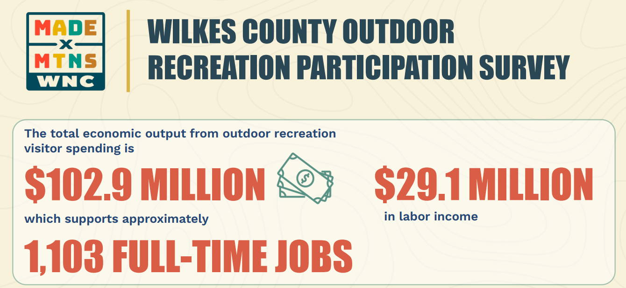
Snapshot of outdoor recreation for economic growth in western north Carolina

Slide 6
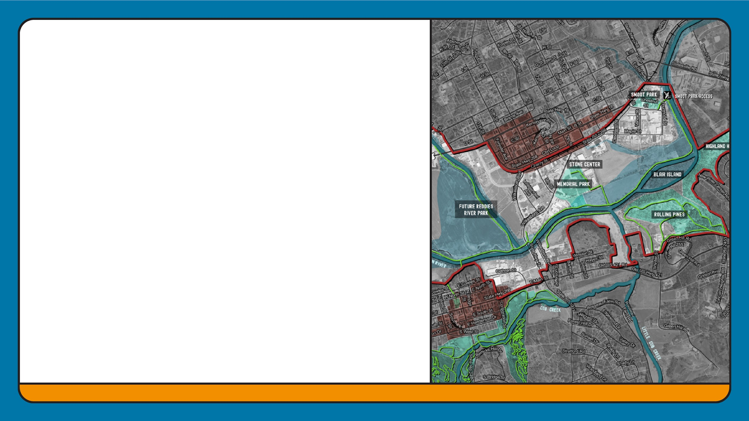
Strategic Position of Site
Proximity to existing recreational assets
Integration with trail systems
Strategic commercial/industrial location
Historical & cultural significance
Brownfield redevelopment opportunity & River District

Slide 7
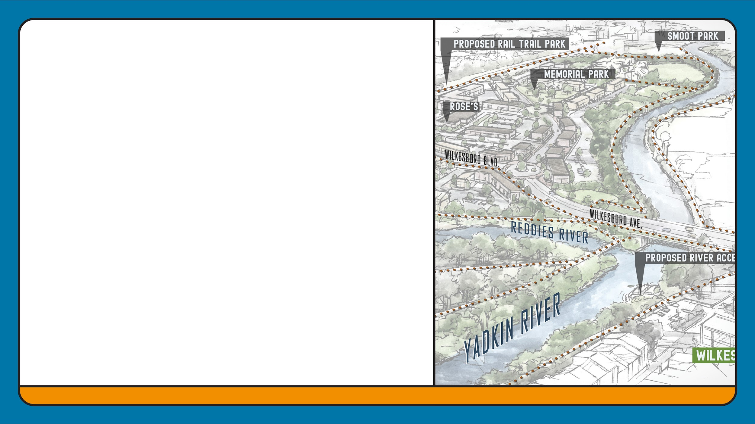
Reuse Options
Must Support…
Economic development
Downtown revitalization & community engagement
Connectivity and access for all modes of transportation
Outdoor recreation and improved quality of life
Smart growth and resilient planning

Slide 8
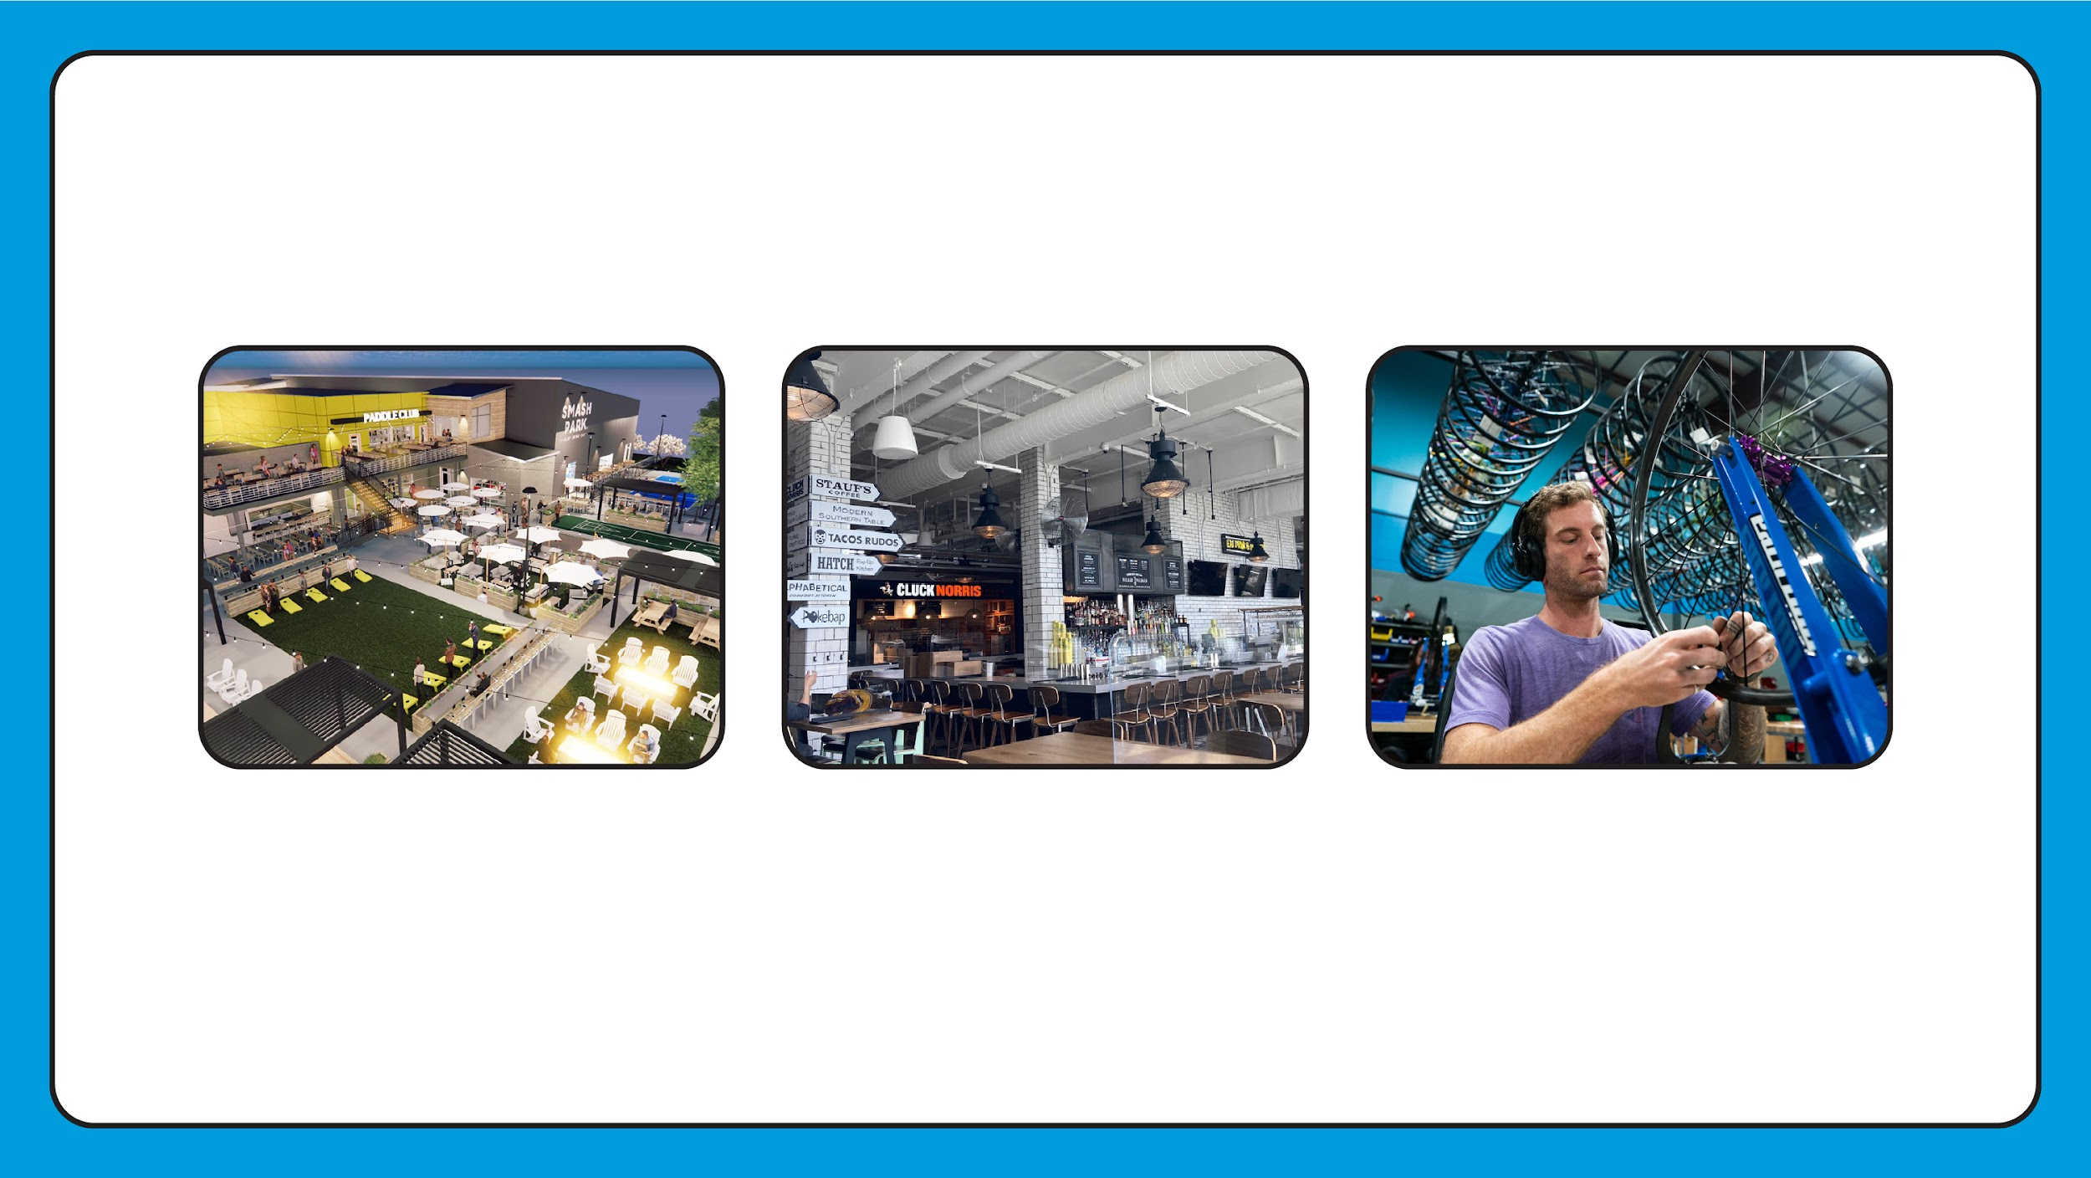
Three Reuse Options Meet All Criteria:
Recreation & Entertainment Venue
Food Hall Incubator Model
Light-Manufacturing for Outdoor Recreation Products
Two case studies focus for tonight

Slide 9
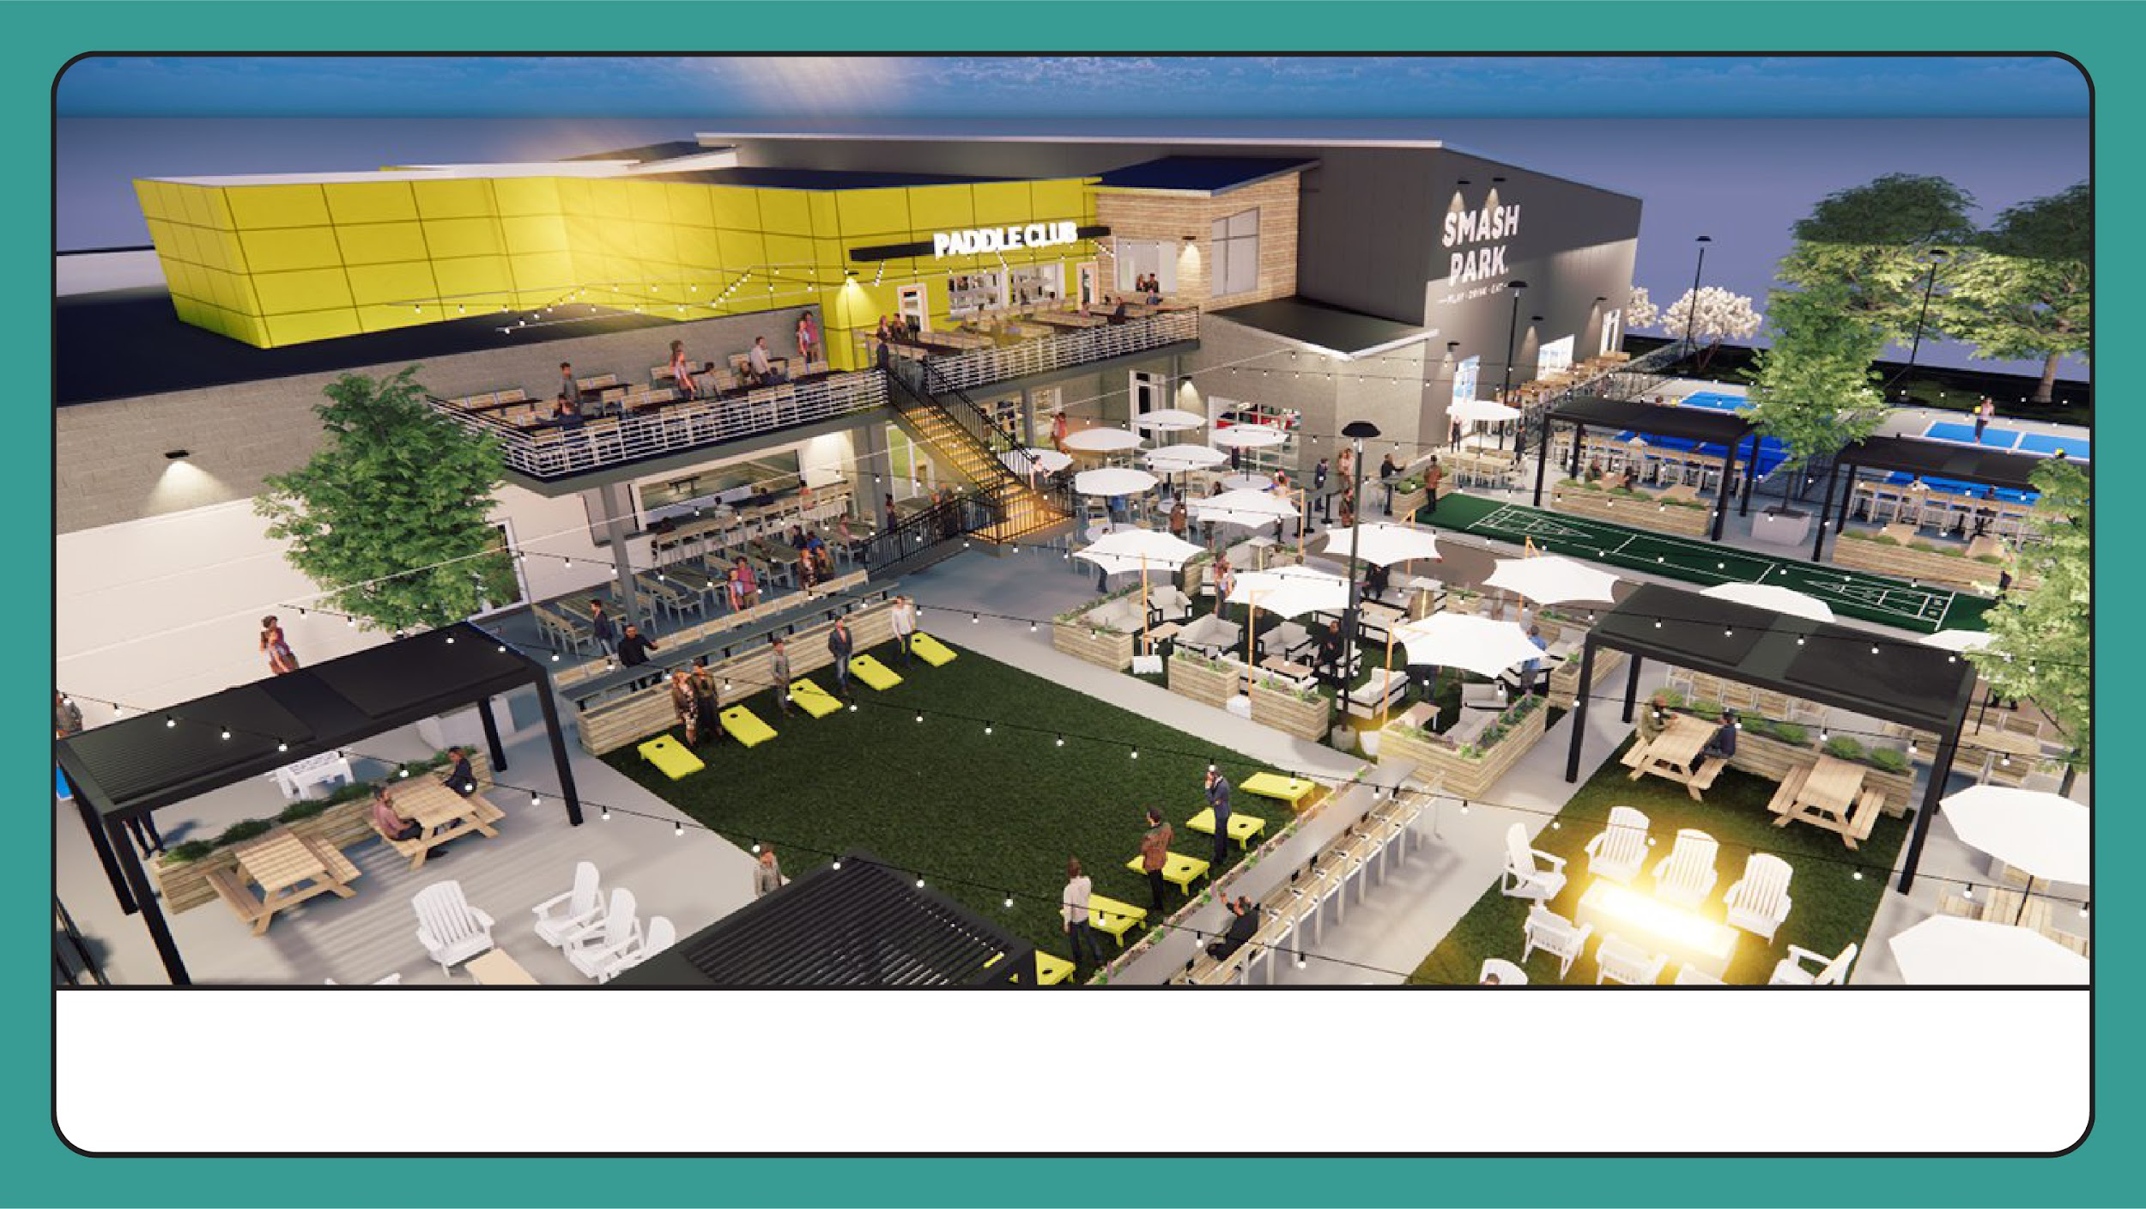
Recreation & Entertainment Venue

Slide 10
Indicators of Demand
Notable population increases in ages 5-14 and 25-34
$1.15 billion on recreation + entertainment spending
$1.08 billion on dining out in 2024
Visitors to Wilkes County spent $114.5 million in 2023
$4M investment in Smoot Park
We have few venues with indoor + outdoor recreation for all ages
We have few venues combining dining with entertainment
We have few venues with direct connectivity to trail + river access

Slide 11
Recreation & Entertainment Venue
Indoor + Outdoor…
Pickleball, cornhole, bocce ball, shuffleboard, etc.
Yard Games
Restaurant + Full-service Bar
Water + Trail Connectivity
Bike, kayak, paddleboard rentals
Community programming

Slide 12
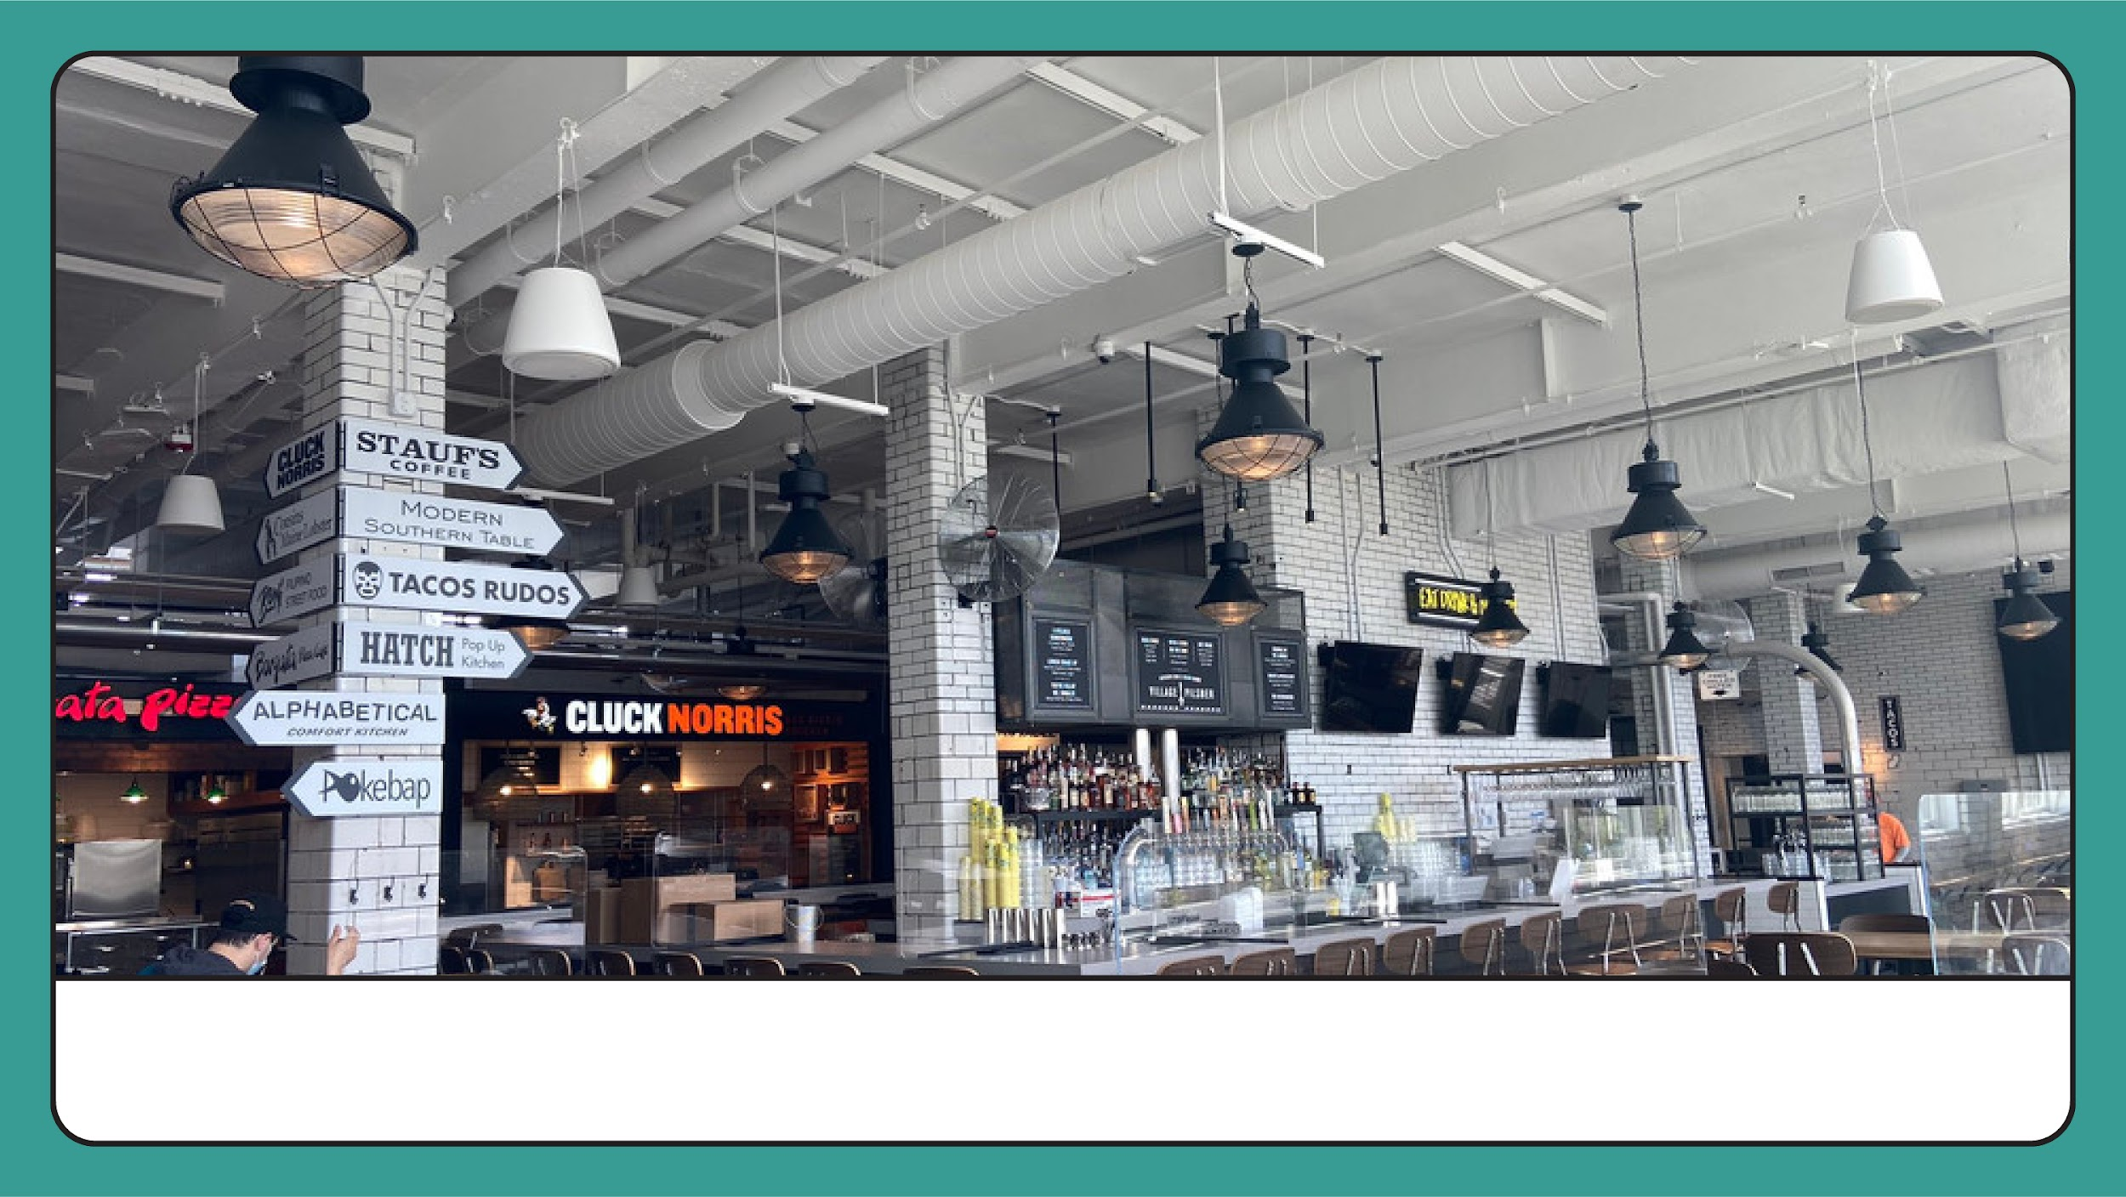
Food Hall - Incubator Model

Slide 13
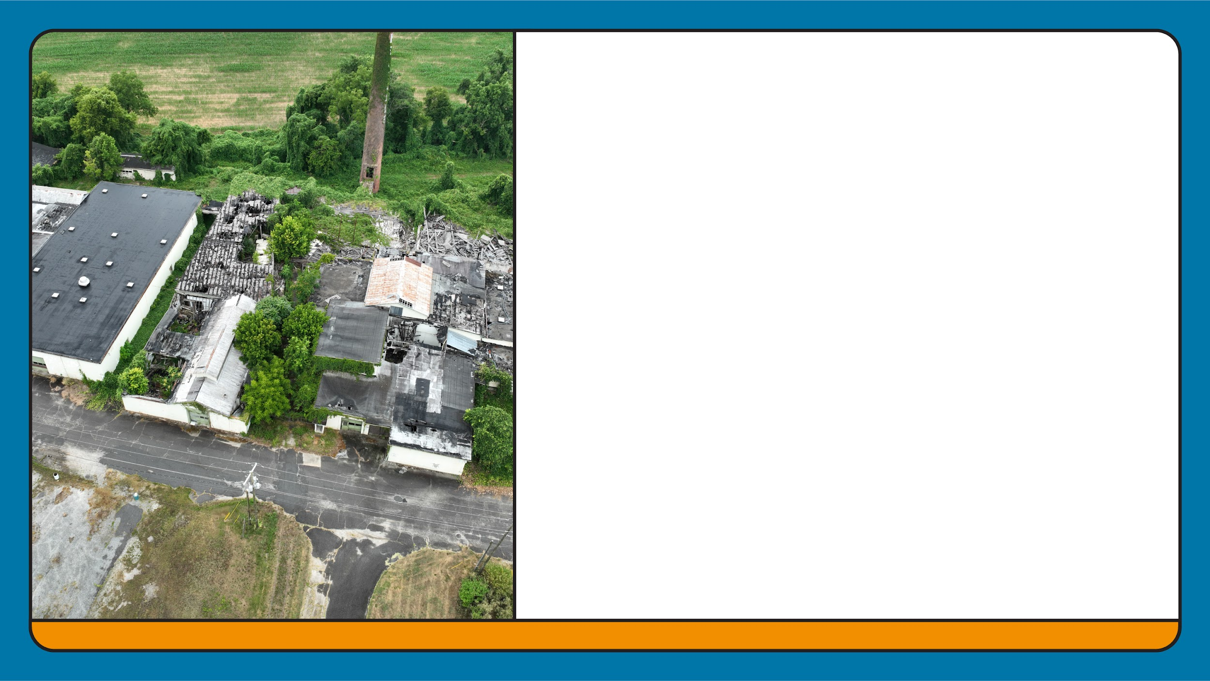
Opportunity Arc
87% of NC visitors want food + drink experiences
Talent pipeline from WCC Culinary Arts Program to build off of
Keep our folks here to work, live, and play
Strong agricultural base for farm-to-table, agritourism growth
Current gaps in cuisine diversity, dining experiences, and food commissaries/commercial kitchens for rent (Food Truck support).

Slide 14

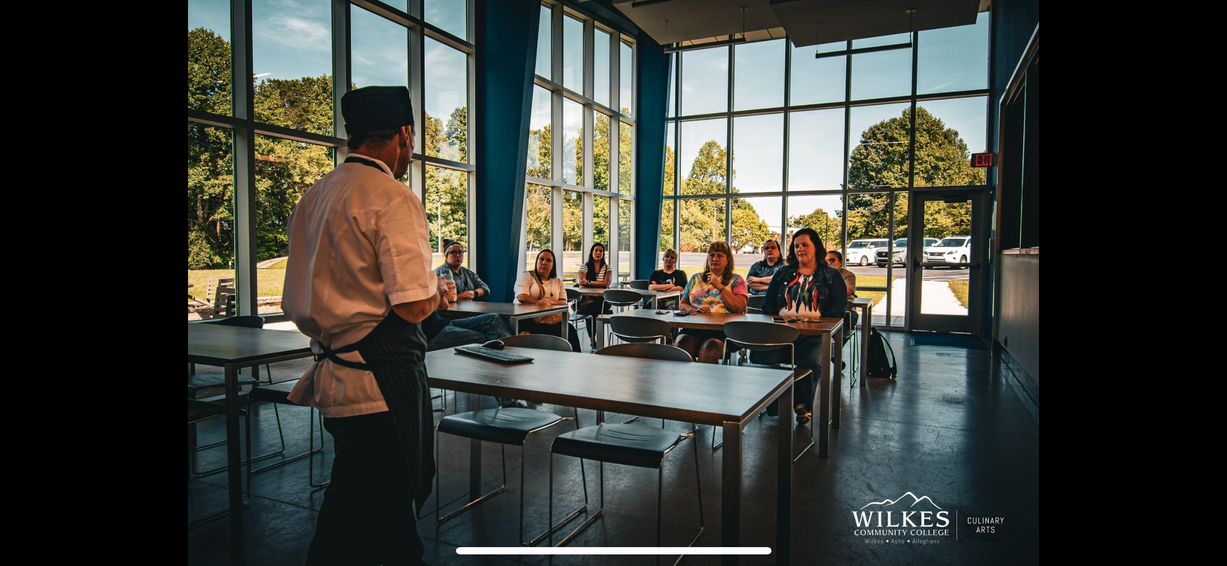
Food Hall - Incubator Model
Business Model: Vibrant food hall + restaurant incubator
Features: Space for emerging culinary talents to launch businesses
Training: Workshops + hands-on learning
Residences: Keep our talented workforce here!!!

Slide 15
Competitive Landscape
Access to Labor
Pipeline development through Wilkes Community College
Cost Savings
Partnerships and incentive programs
Logistical Advantages
Transportation infrastructure (rail, highway, river, air)
Tannery Site offers increased Direct-to-Consumer opportunities

Slide 16
There’s $$ in this redevelopment
Types of Programming | Federal Grants
Environmental Impact | State and Local Programs
Distressed Location | Private Funding
Connectivity to Local, State, Regional Priorities | Philanthropic + Nonprofit Support
Social, Environmental, and Economic Impact | Incentives for Green Building + Sustainable Development

Slide 17
Where we are, where we’re going….
Site Control / Ownership Scenarios
Neighborhood Revitalization Plan (New TAB provider NJIT)
Brownfield Cleanup – In que to apply for EPA’s Clean Up Grant November 14th & Brownfield Agreement with NCDEQ
Designate partnerships to make this happen
Program Design and Tenant Recruitment
Outline of phased approach to development, from site preparation to full build-out

Slide 18
Action Items
Secure Site Control
Leverage Land Design work on Downtown Master Plan + River District Plan
Apply for EPA Grant-NEED FEEDBACK!!!!!
Pursue Neighborhood Revitalization Plan (soon!)

Slide 19
