Slide 1
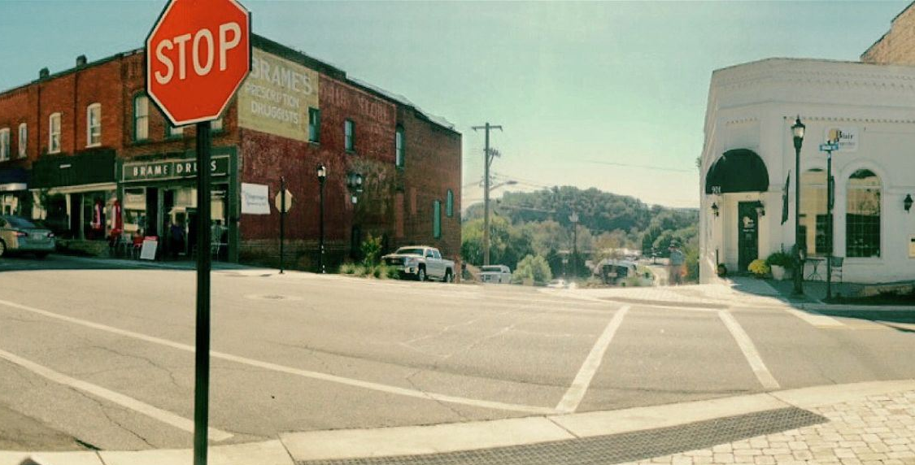

Town of North Wilkesboro
Unified Development Ordinance
Steering Committee Meeting #3
August 8, 2024

Slide 2
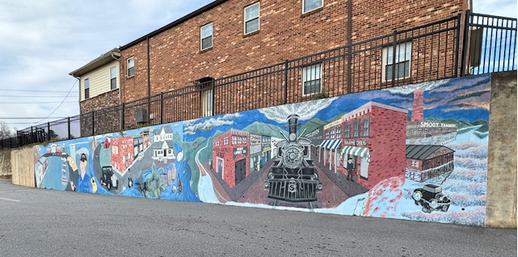
Agenda
Updated Project Schedule
UDO Content Outline
Status Update
Review of Articles 6 & 9
Brief Discussion on Article 7
Next Steps / Questions

Slide 3

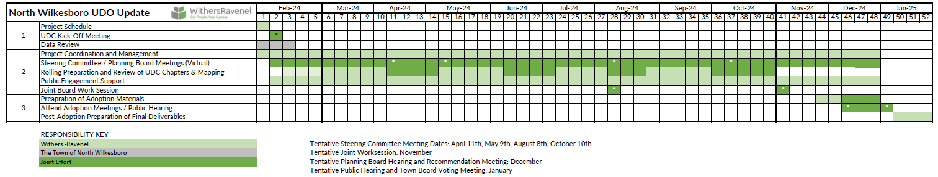
Project Schedule
Project Anticipated Completion: January 2025

Slide 4
Status Update
Article I, General Provisions
Article II, Zoning Districts and Dimensional Standards
Article III, Uses and Supplemental Use Standards
Article IV, Subdivision & Infrastructure
Article V, Environmental Standards
Article VI, Design Standards
Article VII, Signs
Article VIII, Administration
Article IX, Procedures
Article X, Definitions
Legend:
Chapters you have already reviewed.
Chapters that are ready for your review.
Chapters that are in the works.

Slide 5
Article IX: Procedures
Application Submittal
Completeness Review
Administrator
Review
Board of Adjustment Decision
Evidentiary Hearing
Content
Changes
Final plats are now administrative
Discussion
Thoughts on the Development Review Process Table (Section 9.5)?
Longest Article in the UDO
Contains submission procedures (applications, meetings, forms, etc.)
Article is summarized in Section 9.5
Required procedures for different application types are graphically depicted
Administrative modifications are categorized into minor and major
Administrative decisions vs. legislative or quasi-judicial

Slide 6
Article VI: Design Standards
Content
Contains design guidelines for buildings and lots
Changes
Non-residential, mixed-use, and multi-family residential uses may not conist exclusively of metal siding and no more than 50% of exterior materials may be metal.
Discussion / On-Going
Are any addition design standards missing from this article?
Landscaping requirements
Site lighting
Parking
Exclusive use of vinyl siding is prohibited (up to 70% for multi family and 25% for non-residential and mixed use).
At least 50% of primary building materials shall be brick or decorative concrete.
Cross access required between non-residential uses.
Potentially eliminating minimum/maximum parking requirements.
Revised, simplified plant material table.
What have you seen in recent developments that should be standard in future projects?

Slide 7
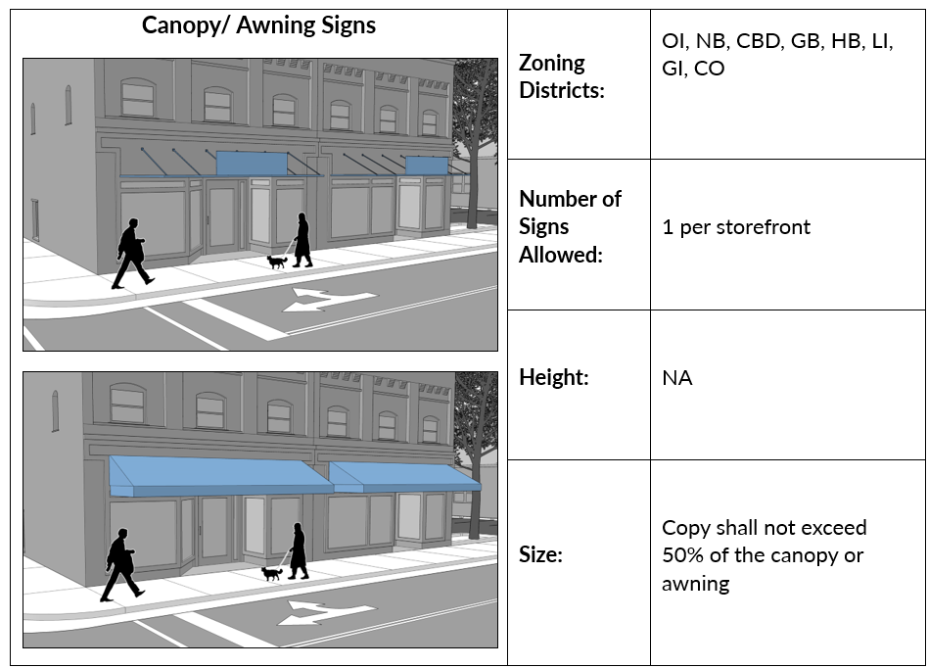
Article VII: Signs
Content
Contains requirements for all signage within the Town, including number, size, and illumination.
Changes
Have added sign renderings for different sign types which can be used as a tool by staff and future applicants when determining appropriate sign types and corresponding requirements.
Discussion / On-Going
Are any sign types missing?
Consolidated all requirements for different sign types into a easily navigable table.
Too strict of requirements or not strict enough with respect to the number and size?

Slide 8
Review of Previous Articles
Article I, General Provisions
Article II, Zoning Districts and Dimensional Standards
Article III, Uses and Supplemental Use Standards
Article IV, Subdivision & Infrastructure
Article VII, Signs
Article VIII, Administration
Article X, Definitions
Questions? Comments?
Were you able to start reviewing any of the Articles? Too much? Difficult to understand?
Need more time or more frequent Q&A?

Slide 9
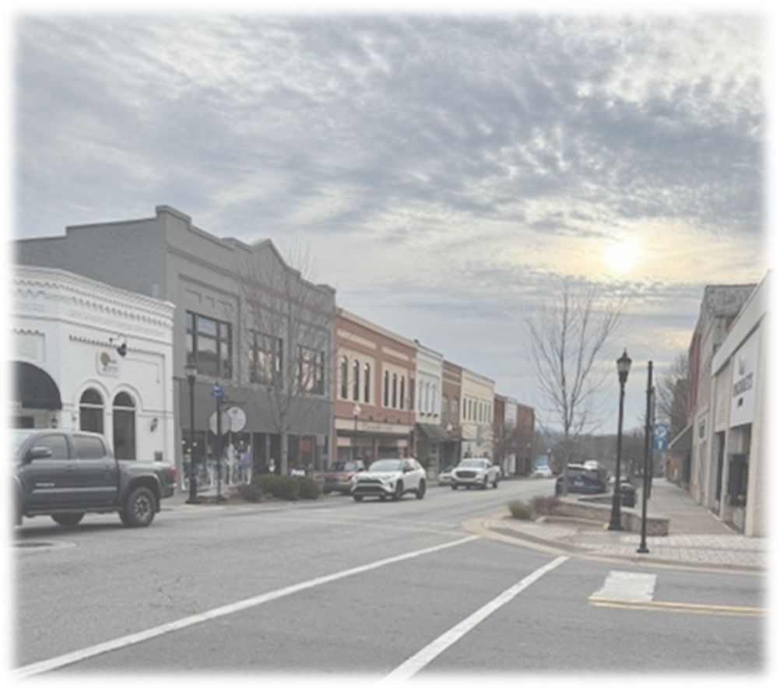
Next Steps
Please review Articles IX and VI (included in your packets)
  Send all feedback to Staff as completed.
Next Steps:
  We are incorporating comments
  Writing next sections
Next Meeting is anticipated to be in October

Slide 10
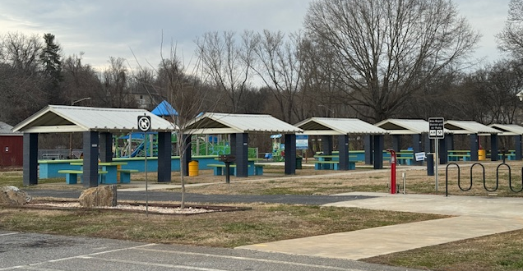
Questions?
Meredith Detsch: planning@northwilkesboronc.gov
Joseph Kamperman: planner1@northwilkesboronc.gov
Office: 336-677-7129

