Slide 1
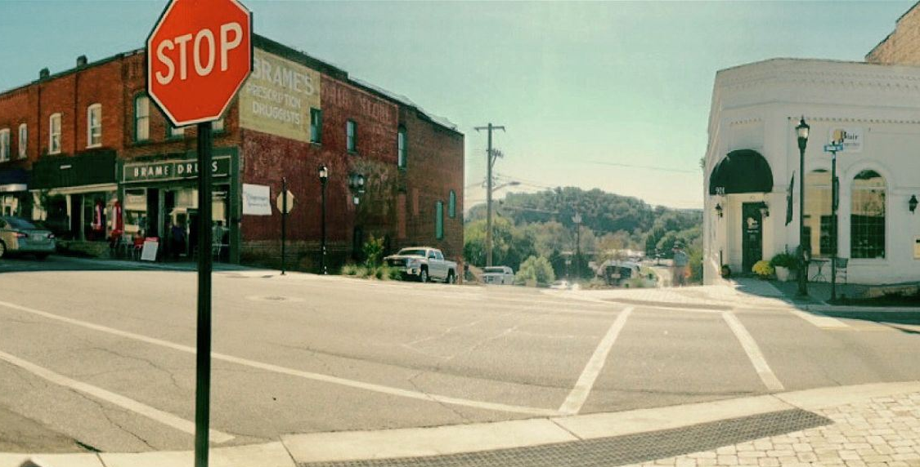

Town of North Wilkesboro Unified Development Ordinance Steering Committee Meeting #1 April 11, 2024

Slide 2
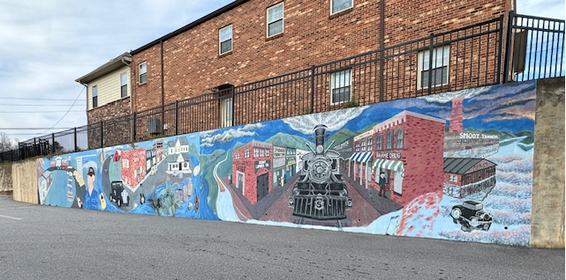
Agenda
Introduction
Project Review
Project Schedule
UDO Content Outline
Status Update
Article I, General Provisions
Article VIII, Administration
Article X, Definitions
Next Steps / Questions

Slide 3


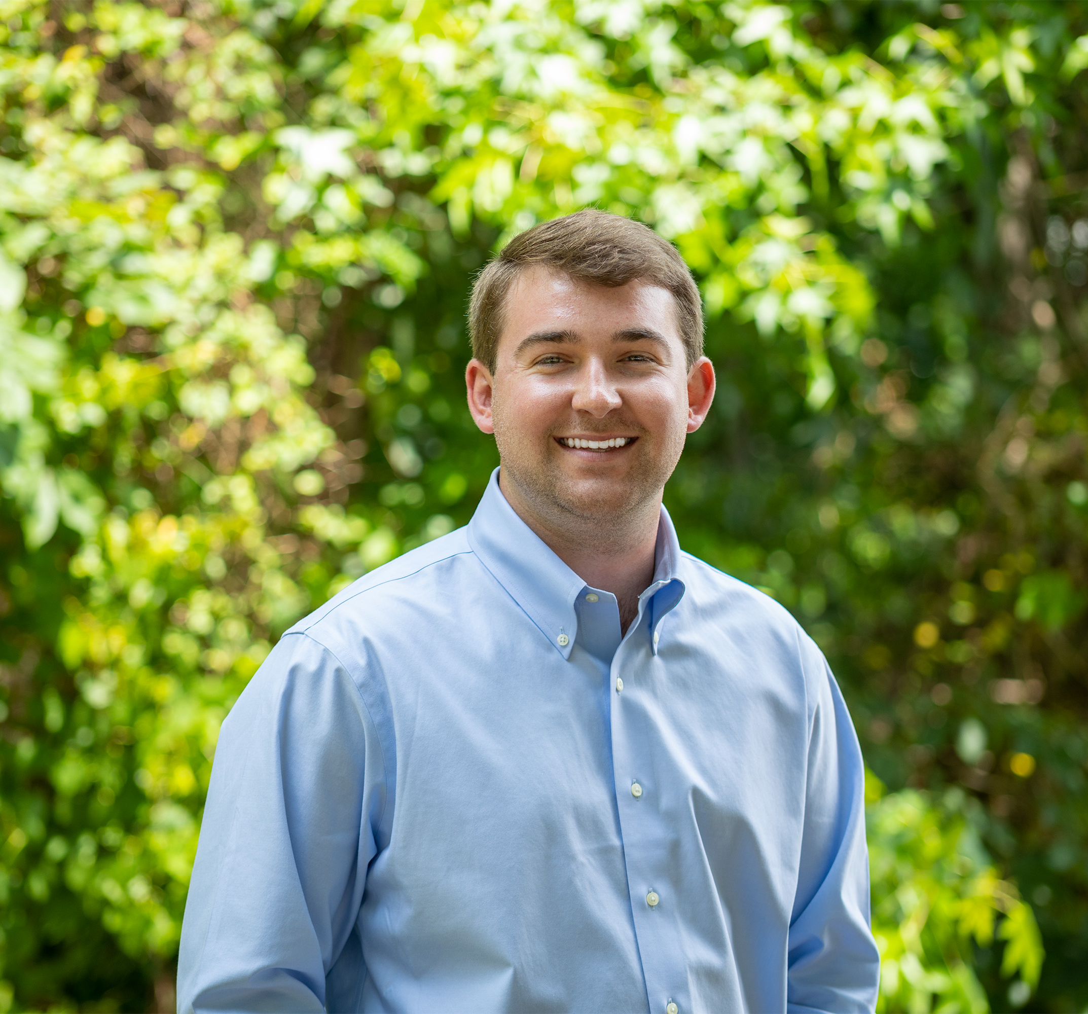


Introductions – Project Team
Karen Mallo, AICP
Project Manager
Greg Feldman, AICP, CZO
Staff Planner
Daniel Rauh, AICP
PM and Senior Planner
Jay McLeod, AICP
Director, Community Planning

Slide 4

Project Review
Administrative Kick Off: January 16
Kick Off Meeting: February 8th
Annotated copy of ordinance as is exists today completed / work-in-progress by Town staff
Meeting recap / Summary of issues and concerns
Took current ordinance and “shuffled” Chapters to fit proposed outline for better flow and easier use
Applied fonts and colors from media plan to ordinance format
Started WRITING!

Slide 5
Project Schedule
Project Anticipated Completion: December 2024

Slide 6
Status Update
Article I, General Provisions
Article II, Zoning Districts and Dimensional Standards
Article III, Uses and Supplemental Use Standards
Article IV, Subdivision & Infrastructure
Article V, Environmental Standards
Article VI, Design Standards
Article VII, Signs
Article VIII, Administration
Article IX, Procedures
Article X, Definitions
Chapters that are ready for your review!
Chapters that are in the works!
Chapters just getting started!

Slide 7
Article I: General Provisions
Content
Discussion
Review of the Purpose of the Code.
Changes
Added a Consistency with Adopted Plans section. Move Vested Development Rights to Procedures.
Contains the legal requirements for the Ordinance and provides the authority, purpose, effective date, and transitional provisions.

Slide 8
Article VIII: Administration
Content
Contains the descriptions of each of the Town Boards and Staff who have roles in the development process. Includes Oath of Office, Minutes, Conflict of Interest, and Duties.
Discussion
Start thinking about potential changes to Procedures (Article IX)– What boards or staff review which applications? What applications should be Administrative? Legislative? QJ?
Changes
Moves all regulations to one place and serves as an intro Chapter to Procedures in Article IX.

Slide 9
Chapter 10: Definitions
Content
Definitions of abbreviations, general terms, and uses.
Changes
Added use definitions to ensure consistency with revised Land Use Table and 160D
Removed and grouped several definitions for similar or like uses.
Discussion / On-Going
Will continue to add/remove definitions as text edits occur.
Identify which definitions need graphics or need to be easier to understand.

Slide 10
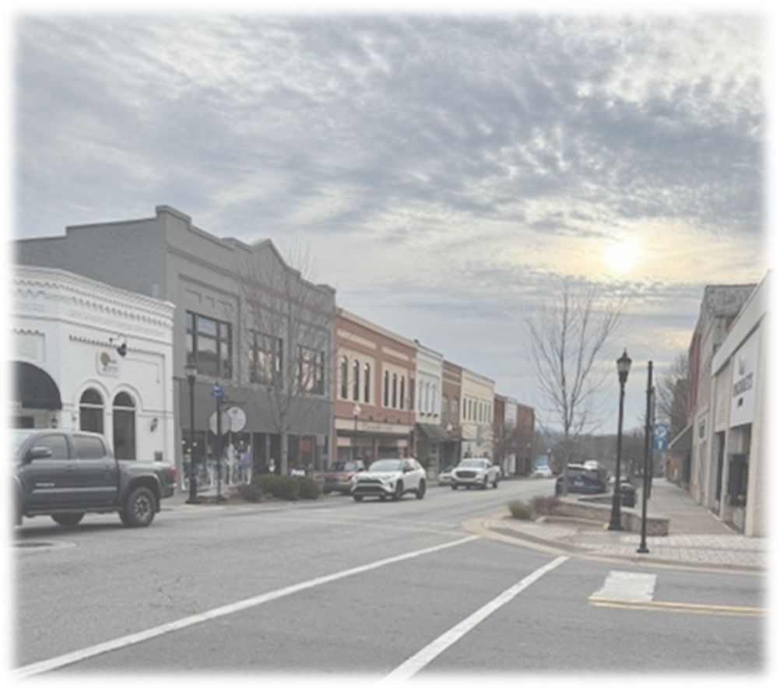
Next Steps
Please review Articles I, VIII, and X (included in your packets)
Send all feedback to Staff as completed.
DUE DATE: Monday, April 22nd
Next Steps:
You will receive a copy of this PowerPoint
A copy of the finalized project schedule
Summary of Meeting Notes from Discussion
Next Meeting:
June 13th

Slide 11
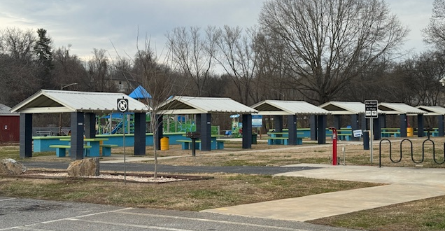
Questions?
Karen Mallo: kmallo@withersravenel.com
Greg Feldman: gfeldman@withersravenel.com

